Slide 1

Data Analysis On Pizza Sales
Pizza Hut Dataset
SQL Analysis

Slide 2
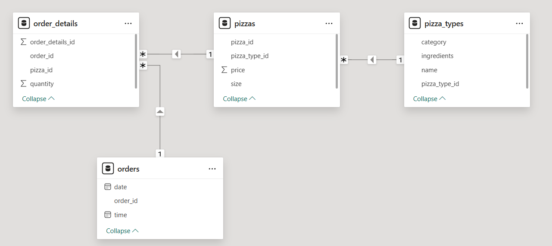
Data Model Presentation
This schema captures pizza sales using a normalized structure.
order_details: Fact table with order_id, pizza_id and quantity.
orders: Adds date and time for each order.
pizzas: Contains price, size and links to pizza type.
pizza_types: Defines name, category and ingredients
Note: This model follows a Snowflake Schema due to multiple related dimension tables. It ensures data consistency and is well-suited for analysis in BI tools

Slide 3
SQL Question Addressed:
Retrieve the total number of orders placed. Calculate the total revenue generated from pizza sales.
Identify the highest-priced pizza. Identify the most common pizza size ordered.
List the top 5 most ordered pizza types along with their quantities.
Join the necessary tables to find the total quantity of each pizza category ordered.
Determine the distribution of orders by hour of the day. Join relevant tables to find the category-wise distribution of pizzas.
Group orders by date to find the average pizzas ordered per day and list the top 5 dates with the highest pizza orders.
Determine the top 3 most ordered pizza types based on revenue.
Calculate the percentage contribution of each pizza type to total revenue.
Analyze the cumulative revenue generated over time.
Determine the top 3 most ordered pizza types based on revenue for each pizza category.

Slide 4
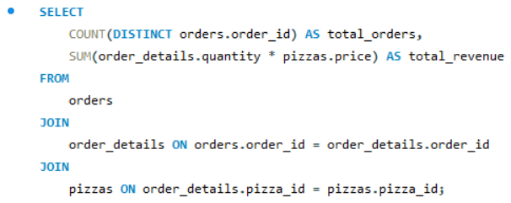

Retrieve the total number of orders placed. Calculate the total revenue generated from pizza sales.
Input Query
Result

Slide 5
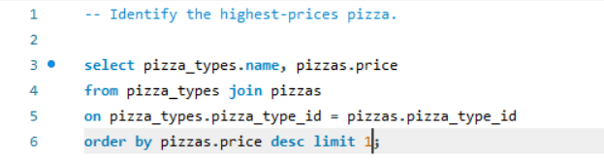
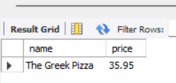
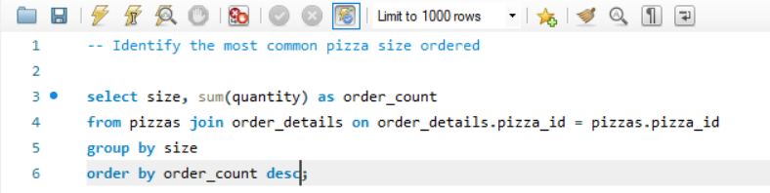
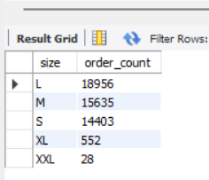
Identify the highest-priced pizza. Identify the most common pizza size ordered.
Highest Price Pizza
Input Query
Result
Most Common Pizza Size Ordered
Input Query
Result

Slide 6
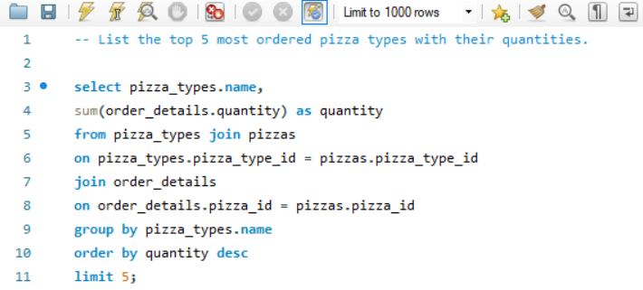
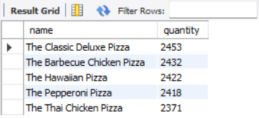
List the top 5 most ordered pizza types along with their quantities.
Input Query
Result

Slide 7
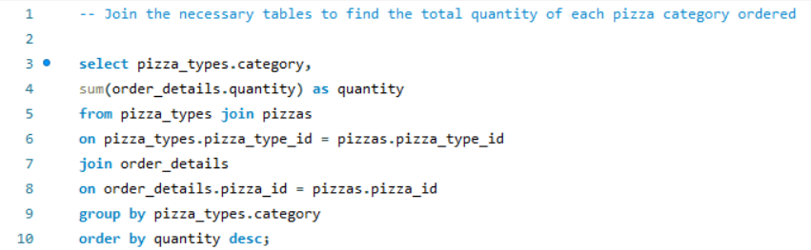
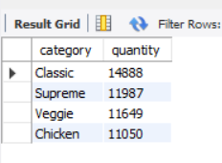
Join the necessary tables to find the total quantity of each pizza category ordered.
Input Query
Result

Slide 8
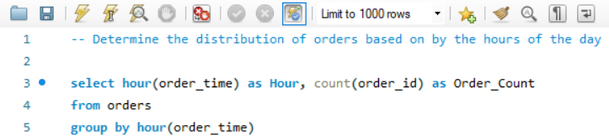
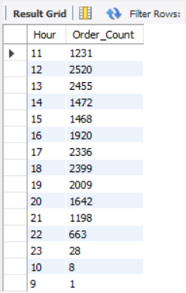
Determine the distribution of orders by hour of the day. Join relevant tables to find the category-wise distribution of pizzas.
Input Query
Result

Slide 9
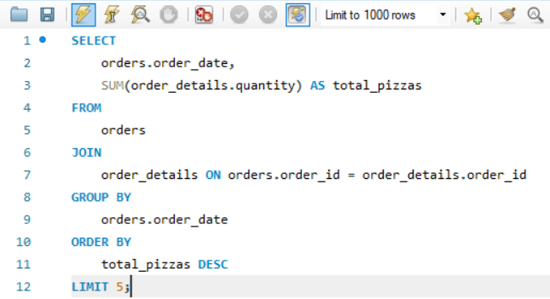
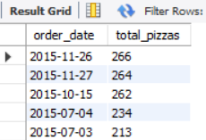
"Group orders by date to find the average pizzas ordered per day and list the top 5 dates with the highest pizza orders."
Input Query
Result

Slide 10
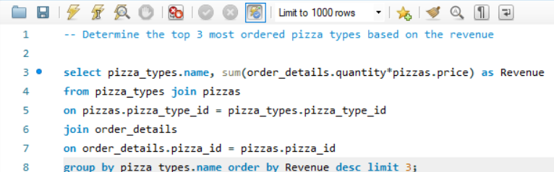
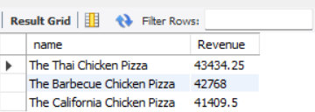
Determine the top 3 most ordered pizza types based on revenue.
Input Query
Result

Slide 11
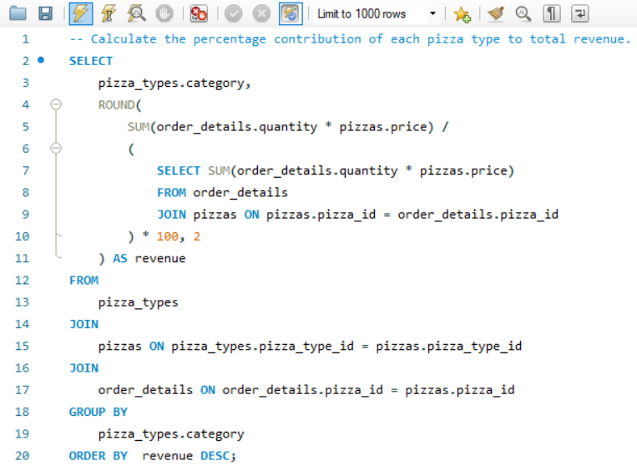
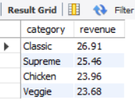
Calculate the percentage contribution of each pizza type to total revenue.
Result

Slide 12
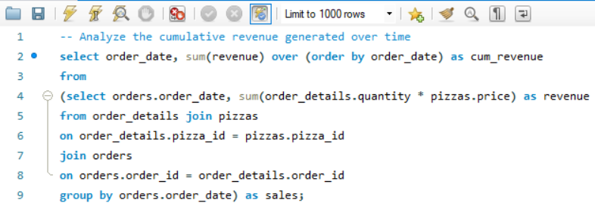
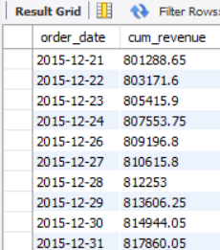
Analyze the cumulative revenue generated over time
Input Query
Result

Slide 13
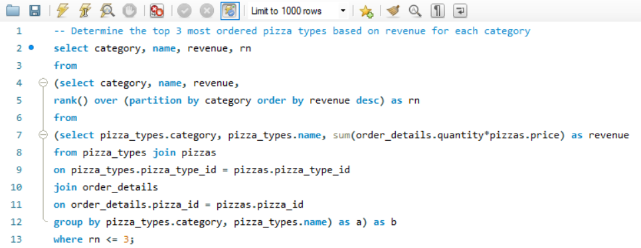
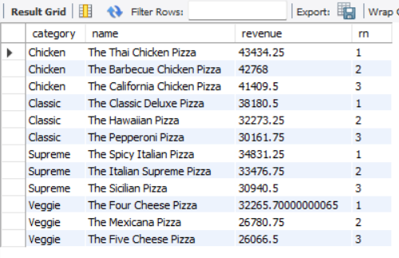
Determine the top 3 most ordered pizza types based on revenue for each pizza category.
Result

